Slide 1
Making this resource work for you
Prior to teaching this lesson, please refer to the ‘Unit Overview and Planning Document’.
Further guidance on planning Science Mastery lessons can be found in the detailed planning guidance document.
Refer to the ‘notes’ section on each slide for useful information, including suggested expositions, pedagogical content knowledge, suggested questions, answers and more. Consider using presenter mode so you can see this guidance throughout the lesson.
The introduction slides can be adapted to suit your teaching style and the needs of your class.
Before the lesson, adapt the fix-it slide to address any misconceptions identified in the previous lesson’s exit ticket.
Choose from the suggested activities to suit your class. The intention is not that you complete all of these, but that you select those which ones are most appropriate for your students. It may be appropriate to further adapt activities for your students.
These lessons are designed to occupy approximately 1 hour. To adapt for a shorter or longer lesson duration we advise you to adapt the activity section accordingly.
Please consider using the final slide to send feedback about this lesson or examples of PowerPoints that you have adapted to our design team. Your feedback is used to improve Science Mastery for all of our teachers and students. We appreciate all suggestions and comments.
Thank you for reading!
The Science Mastery Team

Slide 2

Fractional Distillation
Answer the questions below.
Define a hydrocarbon.
Name the alkane that contains four carbon atoms.
State the general formula of the alkanes.
Describe what happens when a covalent bond is formed.
Explain why covalent molecules have relatively low boiling points.
A molecule made up of hydrogen and carbon atoms only.
Butane
C_{n}H_{2n+2}
Electrons are shared so that each atom gets a full outer shell.
There are weak intermolecular forces between molecules which require little energy to overcome.
Notes:
Big idea: Reactions rearrange matter
Foundation: Name the type of bonding in alkanes.
Stretch: Explain why the alkanes are described as saturated.
Answers:
Foundation: covalent
Stretch: They contain only single (carbon-carbon) bonds.

Slide 3
Alkane | Melting point (ºC) | Boiling point (ºC)
Methane | -182 | -164
Ethane | -183 | -89
Propane | -190 | -42
Butane | -138 | -1
Fractional Distillation
Do Now:
Define a hydrocarbon.
Name the alkane that contains four carbon atoms.
State the general formula of the alkanes.
Describe what happens when a covalent bond is formed.
Explain why covalent molecules have relatively low boiling points.
Drill:
The melting and boiling points of some of the alkanes are given in the table.
Identify which state of matter these alkanes would be at room temperature (20 ºC).
Identify which state of matter these alkanes would be at -50ºC.
Notes:
Drill answers:
All gases
Methane and ethane would be gases, propane and butane would be liquids.

Slide 4
Fractional Distillation
Read Now:
Distillation is a method used to separate a mixture into the different compounds or elements within it based on their boiling points. For example, salt can be separated from sea water by distillation, as when it is heated the water will boil before the salt. The water vapour is then collected into a condenser where it cools down to form a pure liquid. Fractional distillation uses heating to separate the mixture of crude oil into its ‘fractions’, which are groups of different chemical compounds. Each of these fractions contains hydrocarbons of different lengths which are used for different functions. The shortest hydrocarbon molecules are used as gas fuels, while the longer hydrocarbon molecules are used for heavy fuel oil or bitumen for making tar for roads.
State the physical property that distillation uses to separate mixtures.
Describe what happens during distillation.
Explain why crude oil is a mixture.
Explain what is meant by a ‘fraction’ of crude oil.
Give a use of the shorter hydrocarbon chains.

Slide 5
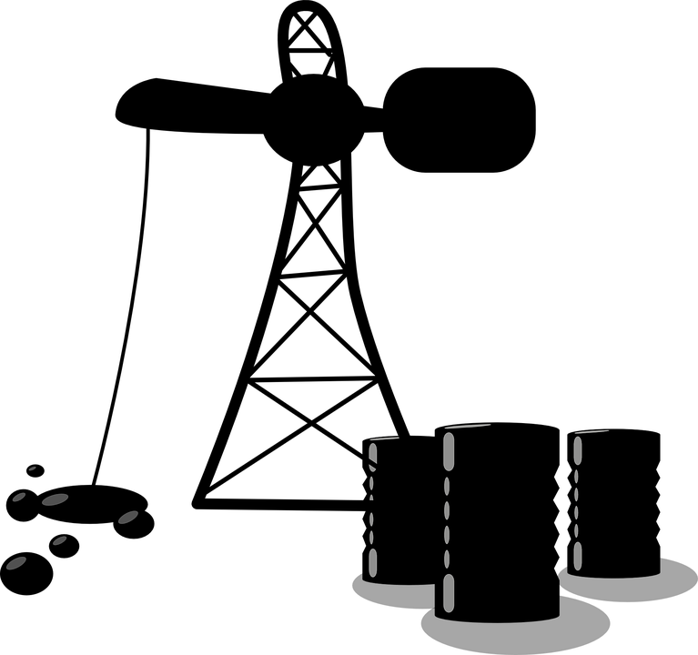
C5.1.3
11/10/2024
Fractional Distillation
C5.1.1 Prior Knowledge Review
C5.1.2 Crude Oil and Hydrocarbons
C5.1.3 Fractional Distillation
C5.1.4 Combustion of Hydrocarbons
C5.1.5 Cracking
C5.1.6 Taking it Further: Alkenes
C5.1.7 Taking it Further: Alcohols
C5.1.8 Taking it Further: Producing Ethanol by Fermentation
C5.1.9 Taking it Further: Producing Ethanol from Ethene
C5.1.10 Taking it Further: Carboxylic Acids
C5.1.11 Taking it Further: Esters
C5.1.12 Polymers
C5.1.13 Taking it Further: Addition Polymerisation
C5.1.14 Taking it Further: Condensation Polymerisation
C5.1.15 Taking it Further: Naturally Occurring Polymers
Notes:
Big Idea: Structure Determines Properties
In the previous lesson students were introduced to crude oil and the alkanes. In this lesson they will look at fractional distillation, linking to the properties of the alkanes.
Suggested Hook:
Show students the table of melting and boiling points from the drill slide.
What is the pattern of melting and boiling points in the alkanes?
The alkane with five carbons is called pentane. What would you predict its melting and boiling points to be?

Slide 6

Following this lesson, students will be able to:
Describe uses of different fractions of crude oil
Describe how crude oil is separated by fractional distillation
Describe and explain trends in the properties of hydrocarbons
Key Words:
fraction
fractional distillation
petrol
diesel
kerosene
viscosity
flammability
Notes:
Guidance:
See unit overview document and planning guidance to see how these objectives are typically assessed at GCSE, including examples of what students should be able to do following this lesson.
Planning for different needs:
The learning objectives given on this slide are suggested based on the most common requirements for exams, however they can be adapted based on the needs of different classes.
For best practice, the unit preparation booklet should be used to determine the appropriate focus of lessons within the unit.
While it is not possible to explicitly split content into levelled grades, we recommend that lesson objectives can be classified as critical, core or stretch.
Critical: the content or skill is essential for all students to be able to progress.
Core: the content or skill is important for students to progress, but other opportunities may be available to revisit it.
Stretch: the content or skill may not be essential for all students but is important for students aiming for the highest grades.
Key skill: this is a crucial skill being developed in this unit as part of the skill mapping
C5.1.3 Lesson Objectives:
Core: Describe uses of different fractions of crude oil
Critical: Describe how crude oil is separated by fractional distillation
Core: Describe and explain trends in the properties of hydrocarbons

Slide 7
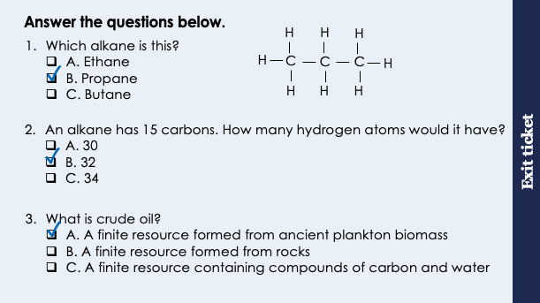
This is the fix-it portion of the lesson
The fix-it is an opportunity to respond to gaps in knowledge, especially those identified by the pre-unit quiz.
The teacher should customise this slide as needed, to facilitate
reteach, explanation, demonstration or modelling of ideas and concepts that students have not yet grasped or have misunderstood.
practise answering specific questions or of key skills.
redrafting or improving previous work.
Notes:
Purpose: to spend time on any gaps identified in previous learning from previous exit ticket.
Guidance from previous exit ticket:
Q1. Answer: B
If students answer A or C, they have not grasped the names of the first four alkanes. To fix it, review the names and formulae of the first four alkanes using the acronym Monkeys Eat Peanut Butter.
Q2. Answer: B
If students answer A, they have doubled but not added two, which is a common error. If students answer C they have added two before doubling. To fix it, give students more practice working out numbers of carbons and hydrogen atoms in different alkanes.
Q3. Answer: A
If students answer B, they have the misconception that crude oil is formed from the rocks themselves rather than found underground under rocks. If students answer C, they have the misconception that ‘hydro’ in hydrocarbons means water rather than hydrogen. To fix it, review what crude oil is made from and where it is found.

Slide 8
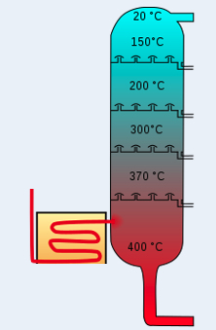
Fractional Distillation
Fractionating Column
Cool (20ºC)
Crude oil is a mixture of different hydrocarbons.
It can be separated into fractions, each of which contains molecules with a similar number of carbon atoms, by fractional distillation.
Hot (350ºC)
Crude oil is heated
Hydrocarbons evaporate
Fractions cool as they rise up the column (as it is cooler at the top)
Heated crude oil
Fractions condense at their boiling points
Notes:
Suggested exposition:
From the last lesson, we know that crude oil is a mixture of many different hydrocarbons. As a whole mixture, crude oil is not very useful. It needs to be separated into fractions, each of which has its own use based on its properties. A fraction contains molecules with a similar number of carbon atoms, so alkanes that are similar sizes. This does not necessarily mean each fraction only contains one type of alkane, just alkanes of similar lengths. This means that the fractions themselves are still mixtures of different compounds.
Crude oil is separated into its fractions by distillation. You should remember from Year 7 and Year 9 that distillation is a method of separating mixtures based on the boiling points of the substances in them. Fractional distillation is simply distillation used to separate a mixture into its fractions.
During fractional distillation, a fractionating column is used. This column has condensers at varying heights. Animate image of fractionating column.
A fractionating column is hot at the bottom and cooler at the top as it is heated from the bottom.
Heated crude oil enters the fractionating column, where most of the hydrocarbons in crude oil are evaporated (turn to vapours) and rise through the column. As the column gets cooler as the vapours move higher, fractions start to condense as they reach the temperature of their boiling point - remember that boiling point is the temperature at which a gas turns to a liquid as well as the temperature that a liquid turns to a gas.
Substances with high boiling points condense at the bottom and those with low boiling points condense at the top.
The compounds in each fraction therefore have similar boiling points. This is because they are similarly sized/lengths of hydrocarbons, so have similar numbers of carbon atoms.
Image from Wikimedia commons.

Slide 9
Fractions of Crude Oil
Fractionating Column
Liquefied petroleum gases
Used for domestic heating and cooking
Petrol
Used as fuel for cars
Kerosene
Used as fuel for aircraft
Diesel
Used as fuel for some cars and trains
Heavy fuel oil
Used as fuel for ships and power stations
Bitumen
Used in roads and roofing
Notes:
Suggested exposition:
Each fraction produced during fractional distillation has a similar number of carbons (or size of hydrocarbons), which is why they are able to be separated by their similar boiling points.
There is a huge range of natural and man-made (synthetic) carbon compounds, which are organised into families of similar compounds.
The fractions can be processed to produce fuels and feedstock for the petrochemical industry, and each fraction has its own use. Many of the fuels on which we depend for our modern lifestyle, such as petrol, diesel oil, kerosene, heavy fuel oil and liquefied petroleum gases, are produced from crude oil.
The fraction with the smallest hydrocarbons has the lowest boiling point, so this fraction condenses in the coolest part of the fractionating column at the top. This is where alkanes such as methane, ethane and propane are found, and they are in liquid form after being condensed so are described as ‘liquefied petroleum gases’.
The next fraction is compounds that are used in petrol. These alkanes usually have between 5-10 carbons in their chains.
The next fraction is compounds that are used as kerosene, which can also be called paraffin (if it is distilled), and contains alkanes with 10-16 carbons.
The next fraction makes up diesel, which is used as fuel for some types of cars (generally larger cars), as well as other larger vehicles like trains. Diesel is made up of alkanes with around 14/15-20 carbons in the chain.
Heavy fuel oil is the next fraction, used as fuel for ships and for power stations that use oil. This is a large fraction containing alkanes with between 20-70 carbons in the chain.
Finally the largest alkane chains make up bitumen, which is used for making tar for roads, as well as in roofing.

Slide 10
Properties of Crude Oil Fractions
Liquefied petroleum gases
Small molecules (few carbons in alkane chain)
Low boiling point
Highly volatile
Flows easily (low viscosity)
Highly flammable
Petrol
Kerosene
Diesel
Heavy fuel oil
High boiling point
Low volatility
Does not flow easily (high viscosity)
Not very flammable
Bitumen
Large molecules (many carbons in alkane chain)
Notes:
Suggested exposition:
Some properties of hydrocarbons depend on the size of their molecules, including boiling point, viscosity and flammability. These properties affect how hydrocarbons are used as fuels.
Liquefied petroleum gases are the smallest molecules, with the fewest carbon atoms in the alkane chain. Bitumen contains the largest molecules, with many carbon atoms in long alkane chains. We can look at the different physical properties of the fractions, including boiling points, volatility, viscosity and flammability, which all change with increasing molecular size.
The fractions with small molecules have a low boiling point (which is why they condense at lower temperatures). They are also highly volatile, which means they will vaporise easily. They flow easily, which means they are not very viscous or have low viscosity. Viscosity is a measure of resistance to flow, so water is not very viscous, but liquids like honey or treacle are very viscous. Smaller molecules are also highly flammable and ignite easily, which is why they are used as fuels in cooking and heating.
The fractions with larger molecules have much higher boiling points (which is why they condense at higher temperatures). They are much less volatile, so unlikely to vaporise, very viscous so they do not flow easily, and are not very flammable so are difficult to ignite.
Each of these properties is affected by the length of the hydrocarbon chain.

Slide 11
Molecule Size and Boiling Point
As molecules get larger, the intermolecular forces between them increase.
Propane
H
H
H
H
C
C
C
H
This means that more energy is required to overcome the forces, increasing the boiling point.
C₃H₈
H
H
H
Dodecane
H
H
H
H
H
H
H
H
H
H
H
H
H
C
C
C
C
C
C
C
C
C
C
C
C
H
H
H
H
H
H
H
H
H
H
H
H
H
C₁₂H₂₆
Notes:
Suggested exposition:
Let’s look at why boiling point is affected by the size of a molecule.
Here we have propane, a small molecule that would be part of the liquefied petroleum gases fraction, and dodecane, a larger molecule, which would be part of the kerosene fraction.
They are still alkanes, so still covalently bonded molecules.
From C4.1, why do covalent molecules have low boiling points?
They have weak intermolecular forces between them, which require little energy to overcome.
As molecules get larger, the intermolecular forces increase, which means they require more energy to overcome. This is what makes them have higher boiling points.

Slide 12




Which statements do you agree with?
Fractions with larger molecules are more volatile than fractions of small molecules
Fractions with larger molecules are more viscous than fractions of small molecules
Fractions with larger molecules are more flammable than fractions of small molecules
Fractions with larger molecules have higher boiling points than fractions of small molecules
Notes:
Suggested points:
This talk task is designed to ensure that students are clear on the properties of the different fractions, drawing out if they understand the difference between high and low volatility and viscosity.
Blue: correct
Yellow: incorrect, they are less volatile
Green: incorrect, they are less flammable
Pink: correct
Suggested guidance:
Talk tasks can be used in a variety of ways to suit the particular needs of the students you are teaching. Through exchanging views with others, students develop their understanding of the science beyond what could be achieved individually.
Science classrooms that successfully integrate talk have the following features:
Science talk is a regular feature of lessons and is woven into classroom activities.
Students are paired or grouped strategically by the teacher to ensure productive interaction. This might take into consideration the students’ proficiency of the English language, how encouraging they might be to peers and their attainment in the topic. It’s a good idea to consider these pairings in the class seating plan.
Students are encouraged and supported to talk, but are not forced to talk.
The teacher should take on the role of a facilitator, engaging with conversations where necessary and encouraging or steering the conversation where needed.
Students are encouraged to use the language they have to express their ideas (e.g., everyday language, imperfect English, native language), but also to incorporate science specific terminology where this is more accurate or has been taught.
6. Scientifically inaccurate ideas are not dismissed by the partner or teacher; open discussion and further investigation are relied on to help students construct ideas that support them to progress in their scientific understanding.
7. Guidelines for behaviour during talk tasks are explicit and frequently reviewed. Rules for students might be:
Listen carefully to your partner
Take turns talking.
Speak one at a time, without interrupting.
Politely agree or disagree and explain why.
Politely point out if your partner has used a scientific word incorrectly, if they have explained the science incorrectly, or if there is a more accurate way to describe something.
If confused, ask questions.
Stay focused on the discussion topic.
Respond to one another.

Slide 13
Describe the process of fractional distillation
Describe how fractional distillation is used to separate crude oil into fractions.
Your answer should include the words:
crude oil
fractions
hydrocarbons
heated
evaporate
boiling point
condense
cooling
height of the fractionating column
Notes:
Key points:
Crude oil is heated
Hydrocarbons evaporate
The column is hotter at the top (so hydrocarbons cool as they get higher up)
Fractions cool and condense
Fractions condense at their boiling point (at different heights in the column)
Examiners this year reported this question was very poorly answered as students did not refer to the heights in the column or to vapours being produces on heating. They also did not write about cooling and condensing which was needed for the mark! I would recommend updating the resources to reflect this or our students will not get the marks for this type of question
Suggested guidance:
Talk tasks can be used in a variety of ways to suit the particular needs of the students you are teaching. Through exchanging views with others, students develop their understanding of the science beyond what could be achieved individually.
Science classrooms that successfully integrate talk have the following features:
Science talk is a regular feature of lessons and is woven into classroom activities.
Students are paired or grouped strategically by the teacher to ensure productive interaction. This might take into consideration the students’ proficiency of the English language, how encouraging they might be to peers and their attainment in the topic. It’s a good idea to consider these pairings in the class seating plan.
Students are encouraged and supported to talk, but are not forced to talk.
The teacher should take on the role of a facilitator, engaging with conversations where necessary and encouraging or steering the conversation where needed.
Students are encouraged to use the language they have to express their ideas (e.g., everyday language, imperfect English, native language), but also to incorporate science specific terminology where this is more accurate or has been taught.
6. Scientifically inaccurate ideas are not dismissed by the partner or teacher; open discussion and further investigation are relied on to help students construct ideas that support them to progress in their scientific understanding.
7. Guidelines for behaviour during talk tasks are explicit and frequently reviewed. Rules for students might be:
Listen carefully to your partner
Take turns talking.
Speak one at a time, without interrupting.
Politely agree or disagree and explain why.
Politely point out if your partner has used a scientific word incorrectly, if they have explained the science incorrectly, or if there is a more accurate way to describe something.
If confused, ask questions.
Stay focused on the discussion topic.
Respond to one another.

Slide 14
Put the stages of fractional distillation in order
Put these steps in order to describe how fractional distillation is used to separate crude oil into fractions.
Hydrocarbons evaporate
Vapours condense
Condensing happens at different boiling points (at different heights in the column)
The fractionating column is hotter at the top (or cooler at the bottom)
Crude oil is heated
E → A → D → B → C

Slide 15
Determine if each of these statements are true or false
False
Fractions of crude oil are compounds
The fractions with the largest molecules have the highest boiling points
Only the fractions with small molecules are used as fuels
Petrol contains smaller molecules than diesel
Fractions with the largest molecules are the least volatile
True
False
True
True
Notes:
Q1 aims to draw out a common misconception. Each hydrocarbon is a compound but within each fraction there is a range of hydrocarbon chains (e.g. LPG fraction contains methane, ethane and propane), so each fraction is a mixture.

Slide 16
Drill
Explain why crude oil is a mixture.
Name the piece of equipment used to separate crude oil into fractions.
State the physical property that fractions are separated based on.
Name the fraction with the smallest molecules.
Name the fraction with the largest molecules.
Give two fractions that are used as fuels for transport.
Describe the relationship between size of molecules and boiling point.
Explain the relationship between size of molecules and boiling point.
Notes:
Purpose: This is a knowledge drill. The purpose of this is to check that the critical knowledge is secure before pupils move onto independent practice.
Suggested guidance: There are a range of ways this could be done depending on time and ability range of the class:
Mini whiteboards
As full sentences in exercise books
As short answers in exercise books
In the pupil workbook
As pair talk
As cold call

Slide 17
Drill answers
It contains different compounds.
Fractionating column
Boiling point
Liquefied petroleum gases
Bitumen
Petrol, kerosene, diesel, heavy fuel oil
Boiling point increases with increasing molecule size
As molecules get larger, intermolecular forces between them increase, requiring more energy to overcome.
Notes:
Purpose: This is a knowledge drill. The purpose of this is to check that the critical knowledge is secure before pupils move onto independent practice.
Suggested guidance: There are a range of ways this could be done depending on time and ability range of the class:
Mini whiteboards
As full sentences in exercise books
As short answers in exercise books
In the pupil workbook
As pair talk
As cold call

Slide 18

I: Describe: to recall facts, events or processes in an accurate way
Example question:
Describe how viscosity changes with increasing molecule size in fractions of crude oil.
To ‘describe’, your answer should:
Use bullet points.
Include each step of the process in a logical order.
Use keywords throughout the answer
Stay focused on the question.
Model answer:
Fractions with larger molecules are more viscous than fractions with smaller molecules
Viscosity increases with increasing molecule size
Notes:
Purpose: The I-We-You section aims to support pupils to build skills that they most commonly need when answering questions associated with this knowledge in the assessment. This section is also used to interleave other content we expect pupils to know at this stage of their education in order that they build a big picture of the science they are learning.
For the ‘I’ activity, the teacher should model how to answer the question. They can do this by narrating their thinking process aloud, and making links to learning earlier in the lesson explicit.
For the ‘we’ activity, the teacher and students work though a similar example together, in order to prepare students to be able to answer a similar question independently.
Opportunities for the ‘you’ activity – independent practise – occur in the activity portion of the lesson once the student is secure enough to process independently.
This slide models the process of answering a describe question.
Firstly, students are presented with a generic describe question, along with a model answer. Students are also given some simple guidance to follow for producing their own describe answer.
The generic question and answer should be used by the teacher to remind students of
the key features of a great answer
how to structure their answer
why the model answer is a good example
Following this, students will be required to apply this process to answer their own describe question, which will appear in place of the generic questions. This describe question will be specific to the topic students are learning about in the lesson. Give students time to write their own answer to this, ensuring that they use the guidance provided. To further scaffold this task for students, it may be appropriate to:
pair students up to write an answer together
list for students the key words you would like them to include in the answer
provide a writing frame or ‘points to include’ for students
A model answer for this question will appear. Teachers should review the model answer with students by referencing the guidance in the green box. For example ‘we can see item 1 in the guidance is to use bullet points to keep your answer clear. Notice in the model answer here we have done just that’. Or ‘item 2 in the guidance here says that we should use scientific keywords in the answer. Has this been achieved in the model answer? Where can we see this?’.

Slide 19
We: Describe: to recall facts, events or processes in an accurate way
Example question:
Describe how volatility changes with increasing molecule size in fractions of crude oil.
To ‘describe’, your answer should:
Use bullet points.
Include each step of the process in a logical order.
Use keywords throughout the answer
Stay focused on the question.
Model answer:
Fractions with larger molecules are less volatile than fractions with smaller molecules
Volatility decreases with increasing molecule size
Notes:
Purpose: The I-We-You section aims to support pupils to build skills that they most commonly need when answering questions associated with this knowledge in the assessment. This section is also used to interleave other content we expect pupils to know at this stage of their education in order that they build a big picture of the science they are learning.
For the ‘I’ activity, the teacher should model how to answer the question. They can do this by narrating their thinking process aloud, and making links to learning earlier in the lesson explicit.
For the ‘we’ activity, the teacher and students work though a similar example together, in order to prepare students to be able to answer a similar question independently.
Opportunities for the ‘you’ activity – independent practise – occur in the activity portion of the lesson once the student is secure enough to process independently.
This slide models the process of answering a describe question.
Firstly, students are presented with a generic describe question, along with a model answer. Students are also given some simple guidance to follow for producing their own describe answer.
The generic question and answer should be used by the teacher to remind students of
the key features of a great answer
how to structure their answer
why the model answer is a good example
Following this, students will be required to apply this process to answer their own describe question, which will appear in place of the generic questions. This describe question will be specific to the topic students are learning about in the lesson. Give students time to write their own answer to this, ensuring that they use the guidance provided. To further scaffold this task for students, it may be appropriate to:
pair students up to write an answer together
list for students the key words you would like them to include in the answer
provide a writing frame or ‘points to include’ for students
A model answer for this question will appear. Teachers should review the model answer with students by referencing the guidance in the green box. For example ‘we can see item 1 in the guidance is to use bullet points to keep your answer clear. Notice in the model answer here we have done just that’. Or ‘item 2 in the guidance here says that we should use scientific keywords in the answer. Has this been achieved in the model answer? Where can we see this?’.

Slide 20
You: Describe: to recall facts, events or processes in an accurate way
Example question:
Describe how boiling point changes with increasing molecule size in fractions of crude oil.
To ‘describe’, your answer should:
Use bullet points.
Include each step of the process in a logical order.
Use keywords throughout the answer
Stay focused on the question.
Model answer:
Fractions with larger molecules have higher boiling points than fractions with smaller molecules
Boiling point increases with increasing molecule size
Notes:
Purpose: The I-We-You section aims to support pupils to build skills that they most commonly need when answering questions associated with this knowledge in the assessment. This section is also used to interleave other content we expect pupils to know at this stage of their education in order that they build a big picture of the science they are learning.
For the ‘I’ activity, the teacher should model how to answer the question. They can do this by narrating their thinking process aloud, and making links to learning earlier in the lesson explicit.
For the ‘we’ activity, the teacher and students work though a similar example together, in order to prepare students to be able to answer a similar question independently.
Opportunities for the ‘you’ activity – independent practise – occur in the activity portion of the lesson once the student is secure enough to process independently.
This slide models the process of answering a describe question.
Firstly, students are presented with a generic describe question, along with a model answer. Students are also given some simple guidance to follow for producing their own describe answer.
The generic question and answer should be used by the teacher to remind students of
the key features of a great answer
how to structure their answer
why the model answer is a good example
Following this, students will be required to apply this process to answer their own describe question, which will appear in place of the generic questions. This describe question will be specific to the topic students are learning about in the lesson. Give students time to write their own answer to this, ensuring that they use the guidance provided. To further scaffold this task for students, it may be appropriate to:
pair students up to write an answer together
list for students the key words you would like them to include in the answer
provide a writing frame or ‘points to include’ for students
A model answer for this question will appear. Teachers should review the model answer with students by referencing the guidance in the green box. For example ‘we can see item 1 in the guidance is to use bullet points to keep your answer clear. Notice in the model answer here we have done just that’. Or ‘item 2 in the guidance here says that we should use scientific keywords in the answer. Has this been achieved in the model answer? Where can we see this?’.

Slide 21
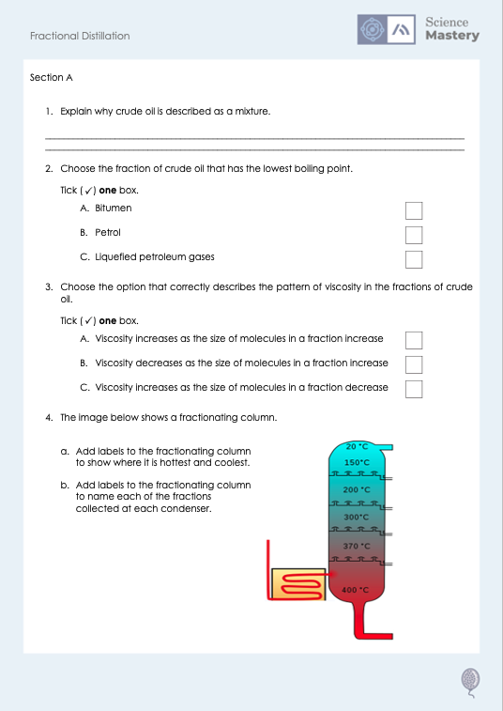
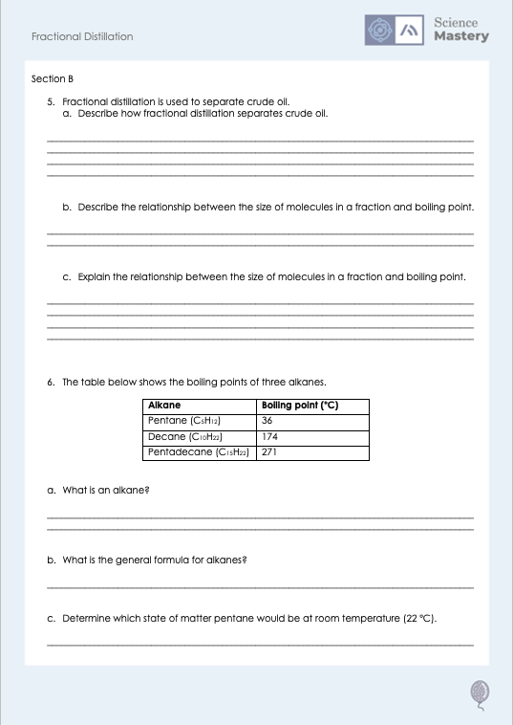
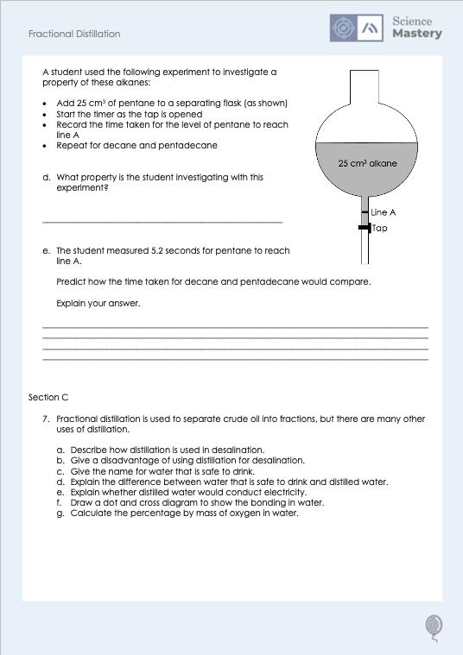
Worksheet

Slide 22
Answers
Liquefied petroleum gases
1. It is made up of different compounds, which are not chemically bonded together.
4.
Cooler
Petrol
2. C - Liquefied petroleum gases
Kerosene
Diesel
3. A - Viscosity increases as the size of molecules in a fraction increase
Hotter
Heavy fuel oil
Bitumen

Slide 23
Answers
5a.
Crude oil is heated
Hydrocarbons evaporate
The column is cooler at the top (so hydrocarbons cool as they get higher up)
Fractions cool and condense
Fractions condense at their boiling point (at different heights in the column)
5b. Boiling point increases as the size of molecules in a fraction increases.
5c. As molecules get larger, intermolecular forces increase so they require more energy to overcome.

Slide 24
Answers
6a. A compound that contains only hydrogen and carbon atoms, and only single bonds (is saturated).
6b. C_{n}H_{2n+2}
6c. Liquid
6d. Viscosity
6e. Decane would take longer than pentane and pentadecane would take longer than decane.
Because the larger the molecule, the more viscous the liquid and the longer it will take to be poured.

Slide 25
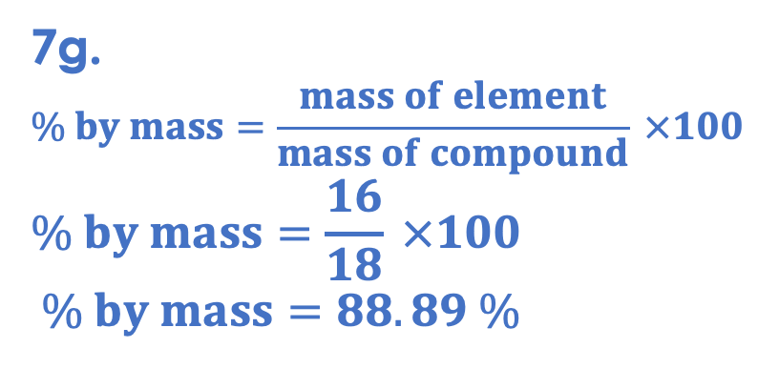
Answers
7f.
X
X
7a. Saltwater is heated, so water is evaporated and condensed, leaving the salt behind.
X
X
X
7b. It requires a large volume of saltwater to be evaporated, which requires a lot of energy so would be very expensive.
X
7g.
$$\% by mass=\frac{mass of element}{mass of compound} ×100$$
$$\% by mass=\frac{16}{18} ×100$$
$$\% by mass=88.89 \%$$
7c. Potable water
7d. Potable water may contain dissolved ions and other substances, but distilled water is pure water.
7e. Pure water would not conduct electricity as it is covalently bonded so there are no free electrons (or dissolved ions) to carry charge.

Slide 26
Answer the questions below.
How does fractional distillation separate crude oil into fractions?
A. Each fraction has a different viscosity
B. Each fraction has a different melting point
C. Each fraction has a different boiling point
✓
Which fraction is used for producing material for roads?
A. Liquefied gases
B. Petrol
C. Bitumen
✓
Which best explains the pattern in boiling points of the alkanes?
A. As the alkanes get longer, boiling points increase because there are more atoms
B. As the alkanes get longer, boiling points decrease because they are more likely to be liquid
C. As the alkanes get longer, boiling points increase because the intermolecular forces increase
✓
Notes:
Q1. Answer: C
If students answer A, they may have confused the idea of viscosity with the heavier fractions. If students answer B, they are not clear on the specific state changes that occur during fractional distillation. To fix it, review why fractions are separated by heating.
Q2. Answer: C
If students answer A, they have got the fractions the wrong way round. If students answer B, they have confused the idea of fuels for cars with the actual road materials. To fix it, review what different fractions are used for.
Q3. Answer: C
If students answer A, they have recognised the pattern is to do with the length of the molecules but not understood that this is due to the intermolecular forces (because there are more atoms). If students answer B, they have the misconception that low boiling points means substances will be liquids. To fix it, review the pattern of boiling points in the alkanes and get students to explain this in their own words.

Slide 27
Lesson C5.1.3
What was good about this lesson? | What can we do to improve this lesson?
Send us your feedback by clicking this link
or by emailing sciencemastery@arkonline.org
Thank you!

